Slide 1
Combinational Logic
Chapter 4

Slide 2
Content List
Decoders
Encoders
Multiplexers

Slide 3
4.9 Decoders
A decoder is a combinational circuit that converts binary information from n input lines to a maximum of 2ⁿ unique output line
The decoders presented here are called n to m-line decodes, where m ≤ 2
Decoder is normally used for other code converters, such as a BCD-to-seven-segment encoder

Slide 4
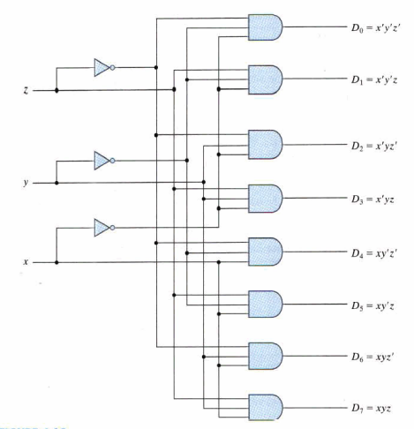
4.9 Decoders
The three-to-eight-line-decoder circuit

Slide 5
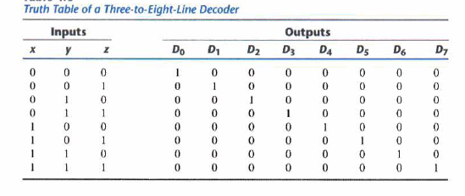
4.9 Decoders

Slide 6
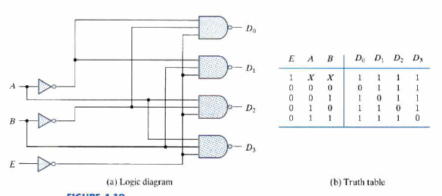
4.9 Decoders
2-to-4-line decoder with NAND gate
Note : it is more economical to produce inverted AND operation with NAND gates

Slide 7
4.9 Decoders
A decoder with enable input can function as a Demux - circuit that receives information from a single Line and directs it to one of 2ⁿ possible output lines
Decoder and demultiplexer operations are obtained from the same circuit, a decoder with an enable input is referred as a decoder-multiplexer

Slide 8
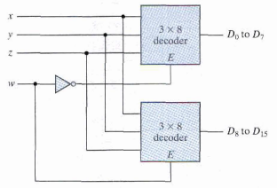
Two 3-to-8-line decoders with enable inputs connected to form a 4-to-16- line decoder
4.9 Decoders
How many 3-to-8 line decoders require to make 5-to-32 line decoder ?

Slide 9
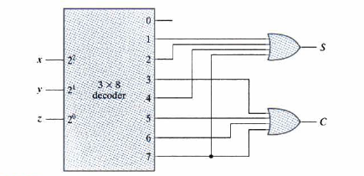
4.9 Decoders
Combinational Logic Implementation
Note : if decoder is designed by NAND gates then at output NAND gates must be used instead of OR gates

Slide 10
4.10 Encoders
An encoder is a digital circuit that performs the inverse operation of a decoder
An encoder has 2ⁿ (or fewer) input lines and n output lines
The output lines, as an aggregate, generate the binary code corresponding to the input value

Slide 11
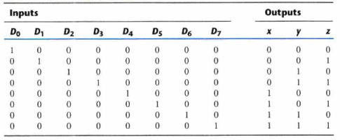
4.10 Encoders
Octal-to-Binary encoder
Higher priority for inputs with higher subscript numbers, and if both D3 and D6 are “1”at the same time, the output will be 110 because & D6 has higher priority than D3
At least one input must be equal to “1”

Slide 12
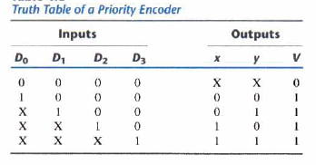
4.10 Encoders
Priority Encoder
A priority encoder is a circuit that includes the priority function
If more than two input equal to “1” , The input having highest priority will take precedence

Slide 13
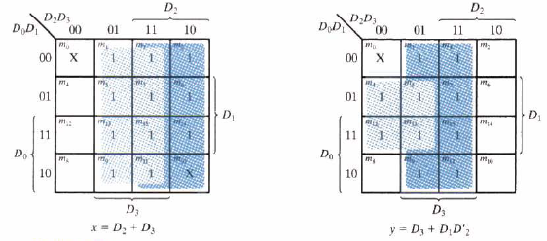
4.10 Encoders
Maps for priority encoder

Slide 14
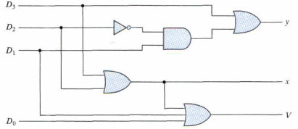
4.10 Encoders
Four input priority encoder Implementation

Slide 15
4.11 MULTIPLEXERS
A multiplexer is a combinational circuit that selects binary information from one of many input lines and directs it to a single output line
The selection of a particular input line is controlled by a set of selection lines
2ⁿ input lines and n selection lines whose bit combinations determine which input is selected

Slide 16
4.11 MULTIPLEXERS
2-to-1 line multiplexer

Slide 17
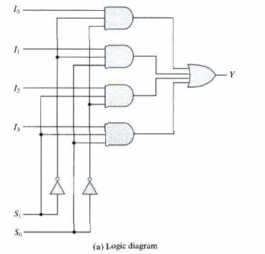
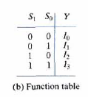
4.11 MULTIPLEXERS
4-to-1 line multiplexer

Slide 18
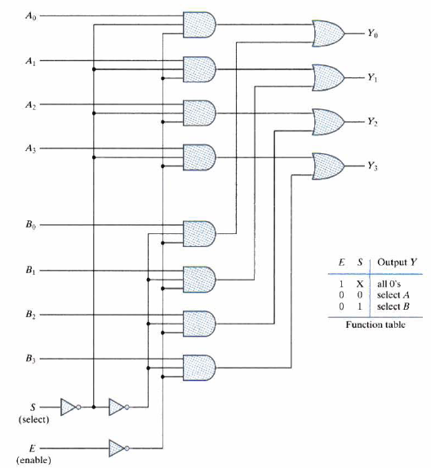
4.11 MULTIPLEXERS
Quadruple 2-to-1-line multiplexer

Slide 19
Boolean function implementation
4.11 MULTIPLEXERS
The first n - 1 variables of the function are connected to the selection inputs of the multiplexer
The remaining single variable of the function is used for the data input
e.g. If the single variable (data input) is denoted by , each data input of the multiplexer will be z, z', 1, or 0

Slide 20
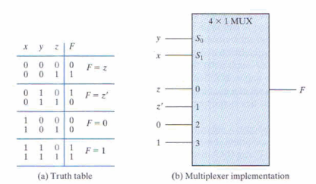
Example:
4.11 MULTIPLEXERS

Slide 21
Three state gates
4.11 MULTIPLEXERS
A multiplexer is constructed with three state gates,
(1) Two of the states are Logic 1 & Logic 0
(2) The third state is high impedance state in which logic behave like open circuit
Graphic symbol for a three-state buffer

Slide 22
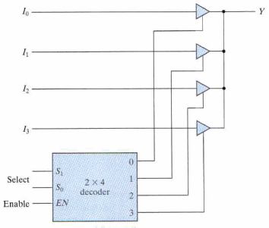
Multiplexer with three-state gates
4.11 MULTIPLEXERS
4- to – 1 line Mux

Slide 23
Home Exercise
4.21, 4.22, 4.23, 4.25, 4.26, 4.27, 4.28, 4.29, 4.31, 4.32, 4.33, 4.35
Task for next lecture
Write a program and Implement the 4.26 with C /C++

